Slide 1
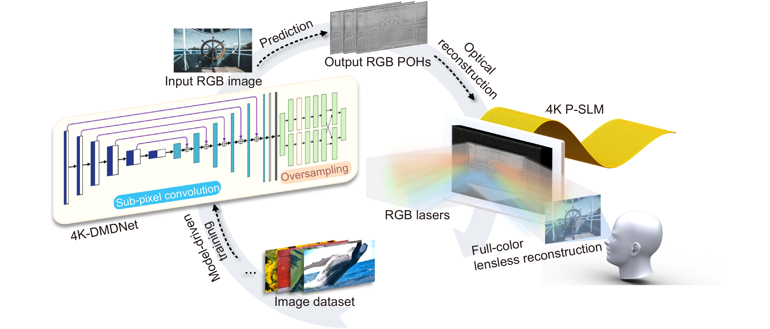
Figure 2. Generation and reconstruction process of 4K POHs by the 4K-DMDNet. The sub-pixel convolution method and oversampling method have played decisive roles to achieve it.
Kexuan Liu,Jiachen Wu,Zehao He,Liangcai Cao
4K-DMDNet: diffraction model-driven network for 4K computer-generated holography
https://doi.org/10.29026/oea.2023.220135

